Slide 1

Lecture 4: IT in Business
Hoger Mahmud

Slide 2



Lecture outline
The concept of Business
E- business
E-Business process
Software and hardware used in Business
Types of E-business
Advantages of using IT in Business
Disadvantages of doing business online
2

Slide 3
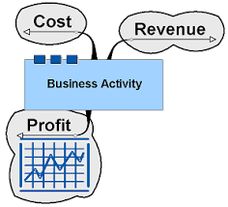
What is Business
Human activity directed towards acquiring wealth through buying and selling of goods.
3

Slide 4
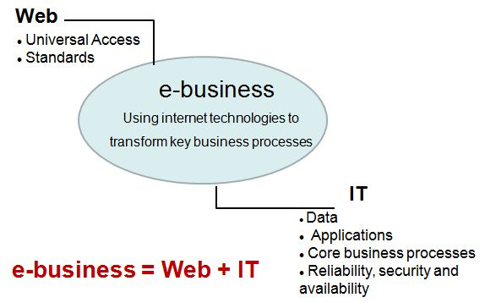
What is E-business
E-business: Any business that takes place by digital processes over a computer network rather than in physical space
4

Slide 5
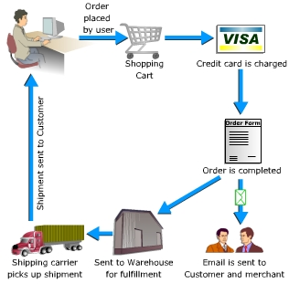
E-Business process
5

Slide 6
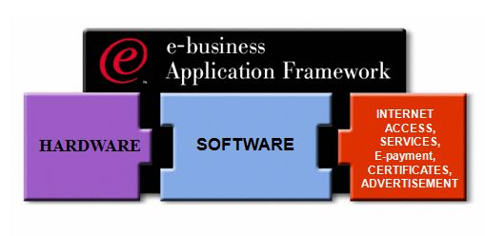
IT Components of E-business
6

Slide 7
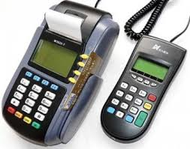
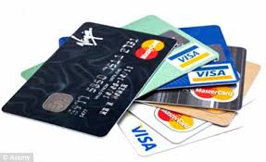

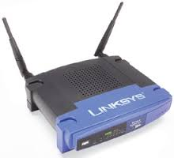
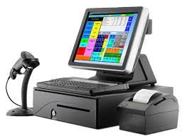
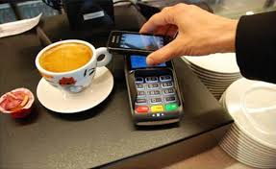
Hardware used in e-business
Computers
Bank cards
Handheld card reader
Network devices
Electronic point of sale
Near field communication
7

Slide 8

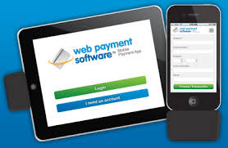

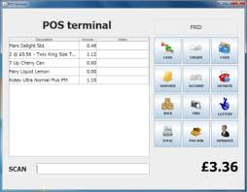
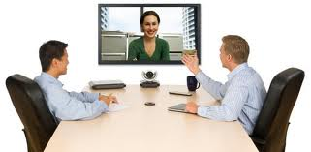

Software used in e-business
Web browsers
Web payment software
Electronic communication
EPOS Software
Video conferencing software
Other software
8

Slide 9
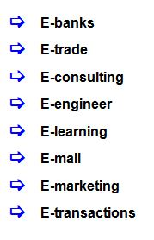
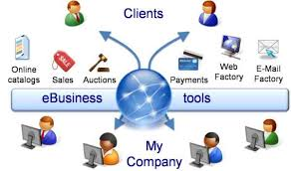
E-business Categories
9

Slide 10
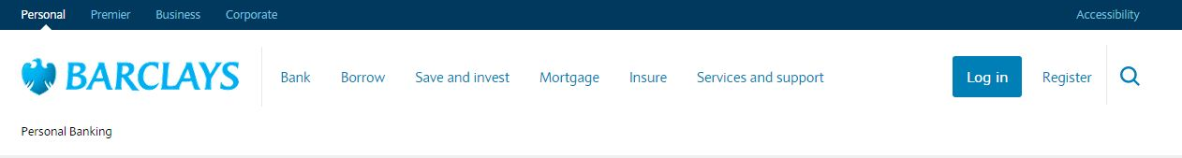
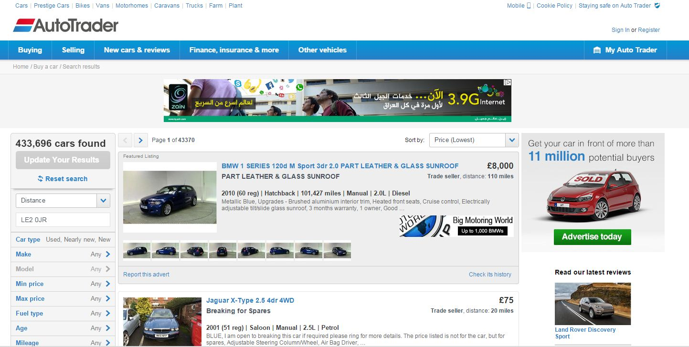
example of e-trade and e-bank
10

Slide 11
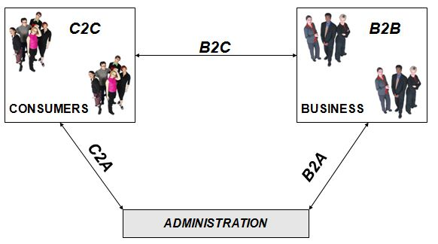
Types of E-Business
11

Slide 12
Types of Business explained
Business-to-business
two (or more) businesses make transactions electronically.
Business-to-consumer
companies sell directly to consumers over the Internet.
Consumer-to-consumer
consumer sell directly to consumer over the internet
12

Slide 13
Advantages of e-business
Expands a company’s marketplace to national and international markets
Allows a producer to reach a large number of customers, anywhere around the globe, at a very low cost
Enable companies to get material and services from other companies, quickly and at less cost
Makes marketing and advertising for products cheap
Decrease the cost of creating, processing, distributing ,storing, and retrieving paper-based information
Reduces the time between the outlay of capital and the receipt of products and services
Helps small businesses compete against large companies
13

Slide 14
Disadvantage of e-business
Fraud on the Internet
Using someone else identity to buy or sell products
Product manipulations, selling cheap and copy staff as original
order get lost or undelivered
14

Slide 15

Thank you
?

